Slide 1





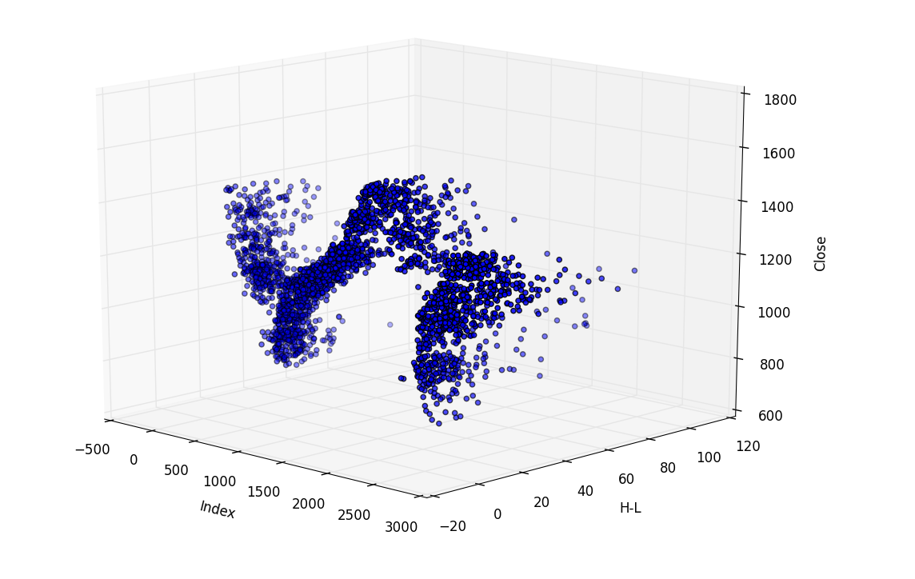


NYC311 Service Requests
2015
Erica Liz
IS 362 – Fall 2017
Professor: Dr. Charles Pak

Slide 2
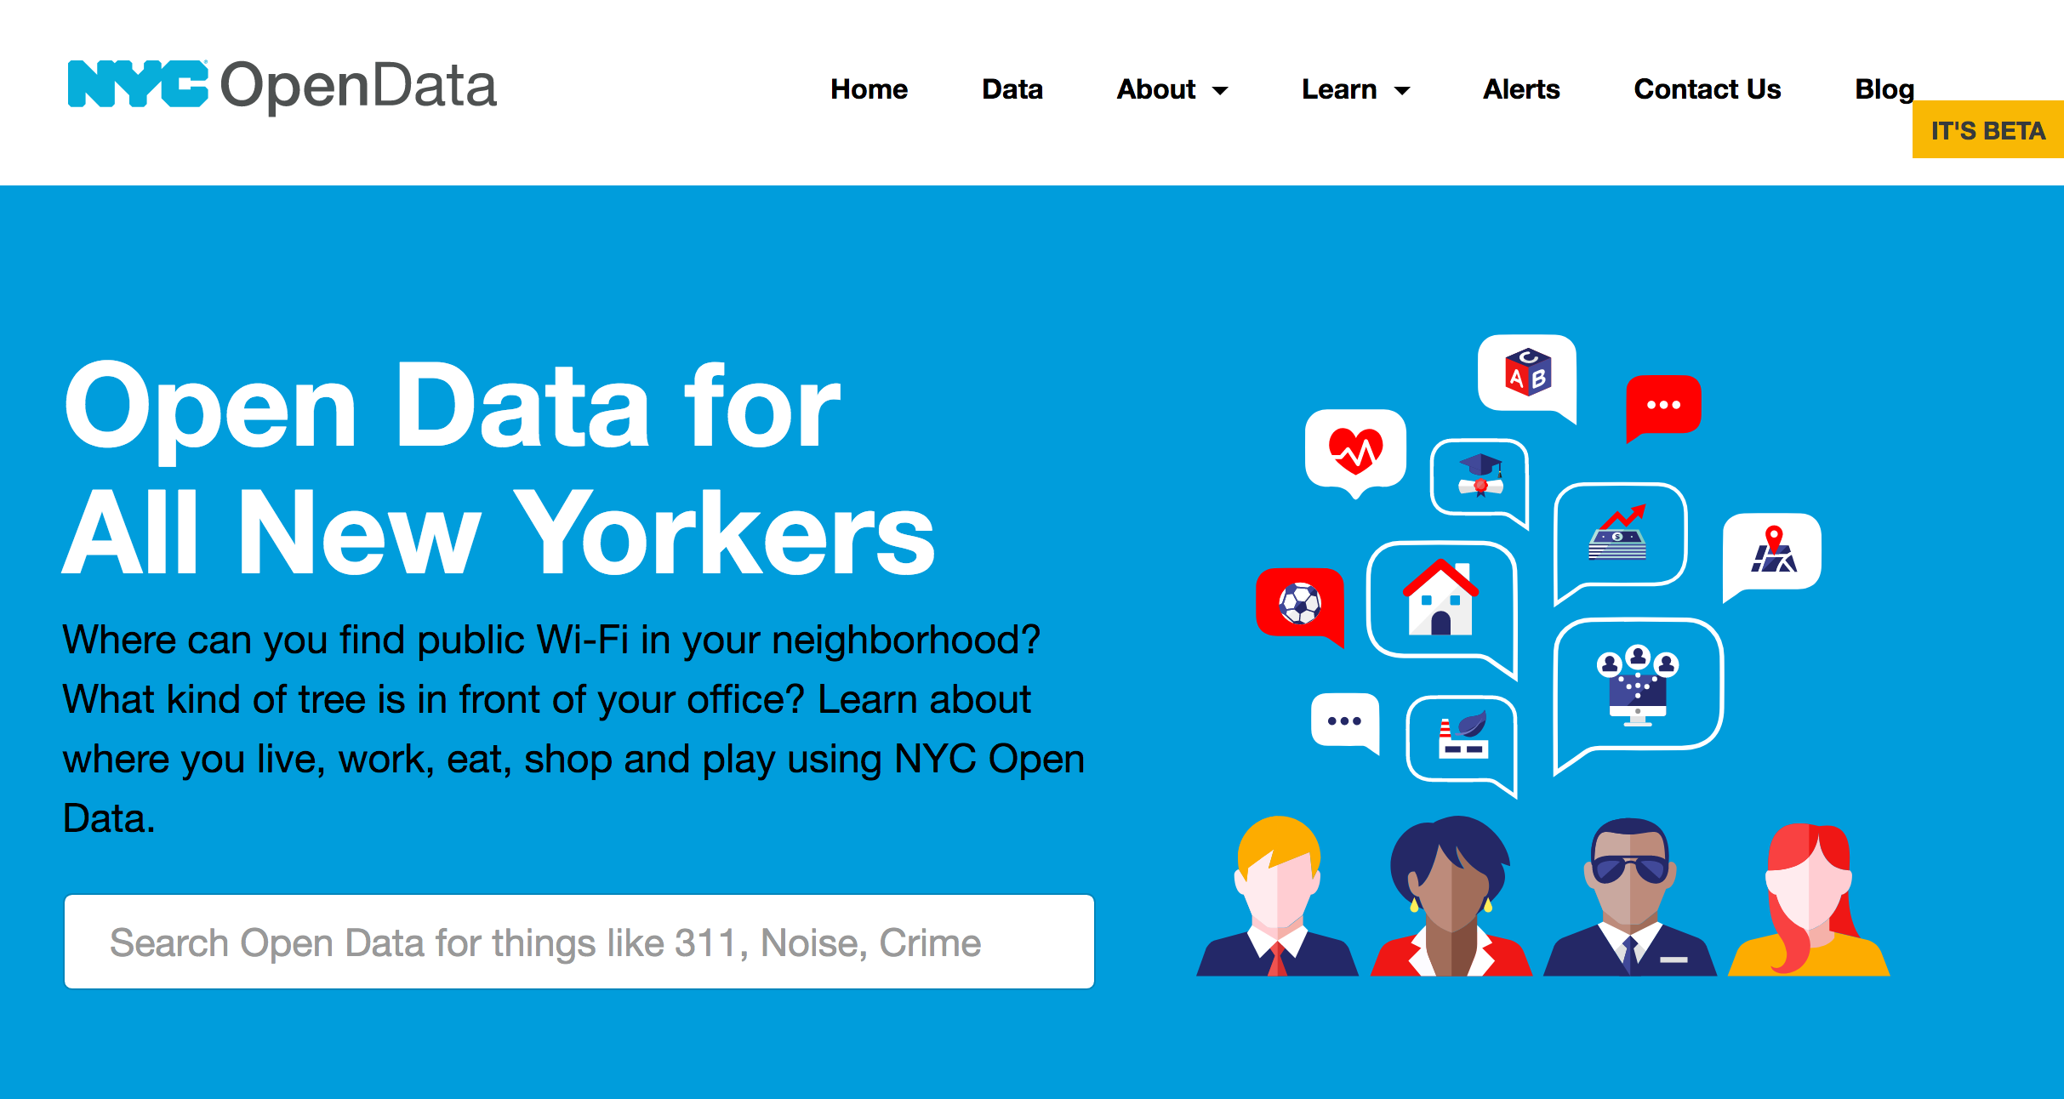
NYC Open Data - Data Source
The data is obtained from NYC OpenData. Some tweaks were made to the data and customized to fit my needs for the project. I focused on 311 Service Requests for 2015. I planned to use some charts to display results and some images (if I can figure out how). I would use the data to analyze the following:
The top service request in 2015
The season with the most service requests
The borough with most service request
The total of service requests in 2015. How many remain open? How many have been closed?

Slide 3
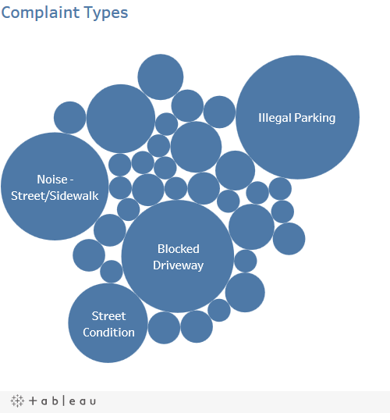
Clean up & Transform
The data was large & so I filtered out only 200 for the results. This would reduce the wait time for running the code.
I began by removing all the ‘NaN’ values and replaced them with “0”.
I proceeded to learn what data types I was working with to make it easier or so I thought.
I encountered a problem when it came to working with “Date &Time” datatypes; so I decided to proceed with what I knew I could do first.
I began with answering my first question. To do so I used ‘value_counts’ and created a chart to display using Tableau. (a software for data visualization).
I continued unto my third & fourth questions in a similar matter.

Slide 4
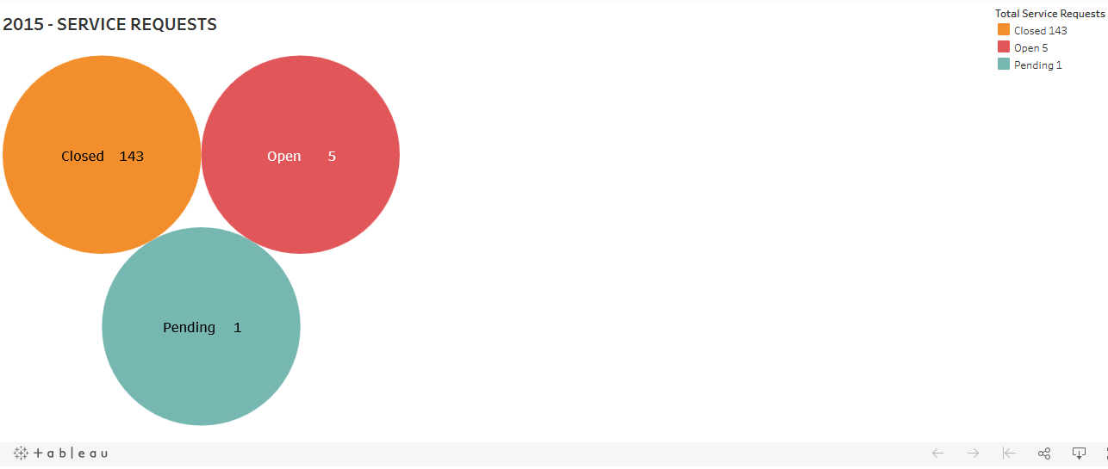
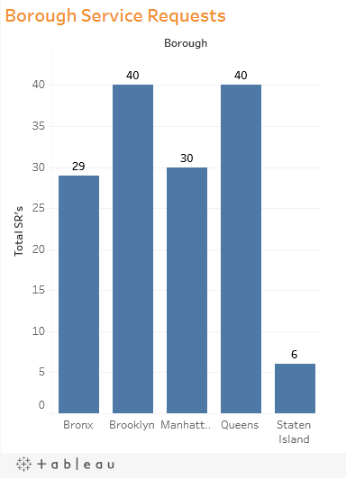
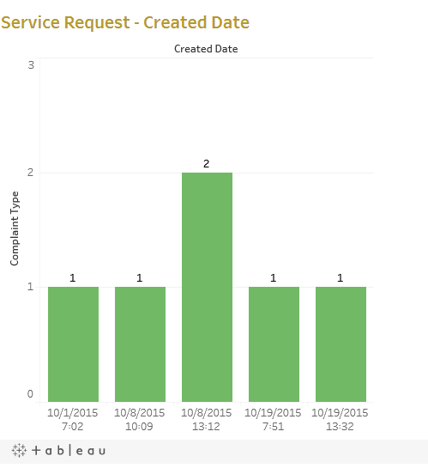
Some more graphs….

Slide 5

Conclusion
My biggest challenge was working with date and time dataframe. I needed to know which season received the most service requests; but my column for date & time were together. I tried sorting by dates but that didn’t work. I then tried separating the date from time and neither was successful. My last option was grouping which finally worked. By using the value counts algorithm I was able to find the amount of incidents for each day which gave me the result I was looking for from my data.
Another challenge was adding an image to my project. I was able to read a few topics on adding images using Jupyter Notebook and it finally worked. I used a video I found on YouTube. This was exciting for me as I attempted in other projects and wasn’t able to do so.
The problem encountered with the created date field could had been less challenging if the data would allow one to filter out by dates only. But unfortunately the data was for the entire year.

